Slide 1
Banking Application
Team - Blitzkrieg
Akash Nainani Haindavi Bondugula
Musthyala Srikar Nagendra Singh
Sarah Naik Saurabh Kumar
Shwetha S Sunanda Saha
Swarajdeep Saha Syed Safdar Ali

Slide 2
Introduction
The project is an online banking application for customers of a bank to open an account, view the account information and execute basic banking operations.

Slide 3
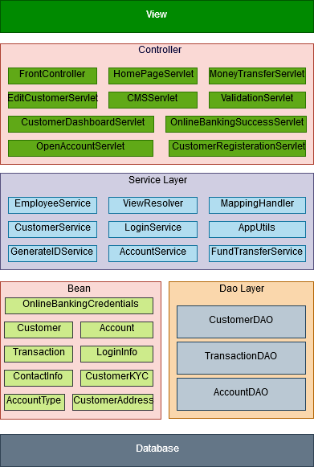
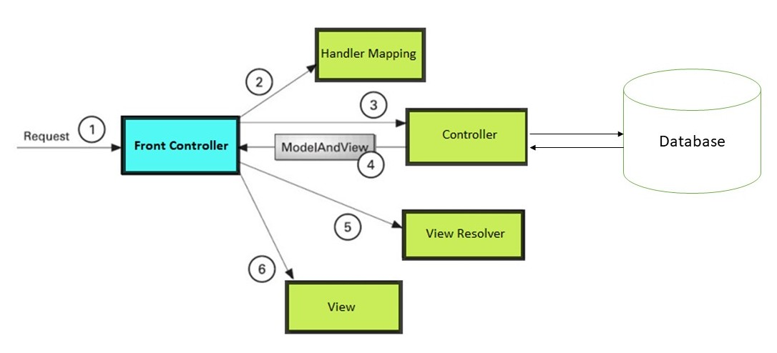
Architecture Diagram

Slide 4
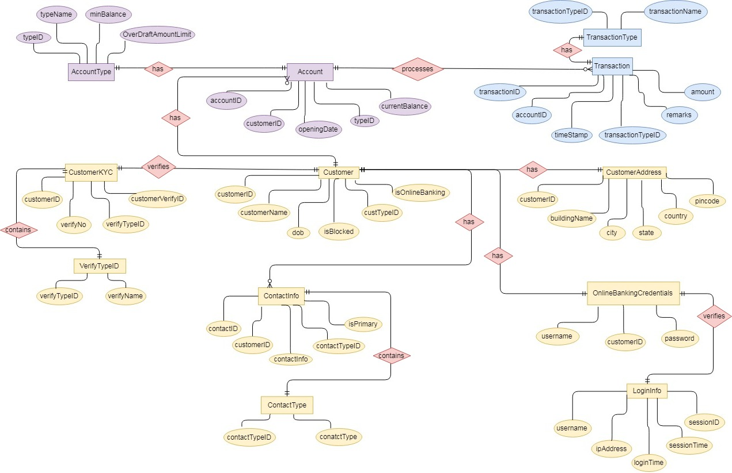
ER Diagram

Slide 5
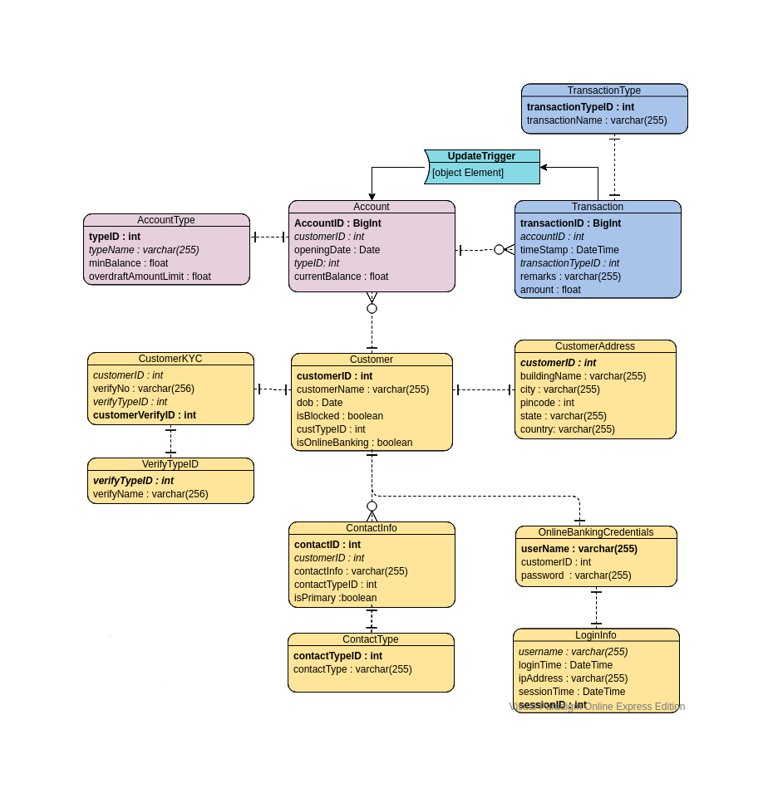
Table Schema
Diagram

Slide 6
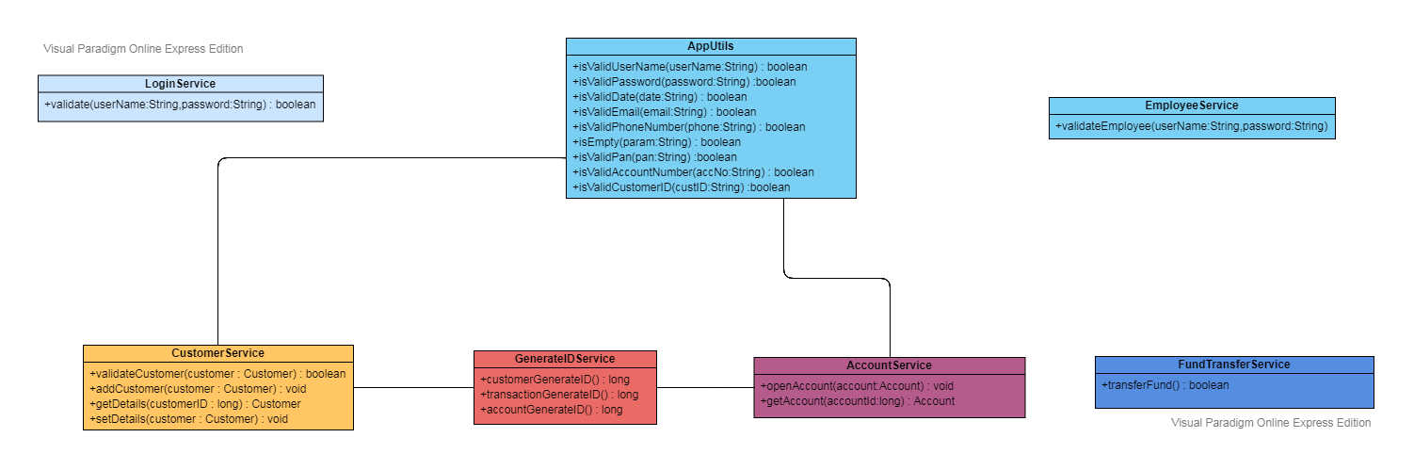
Class Diagram
(Service Layer)

Slide 7
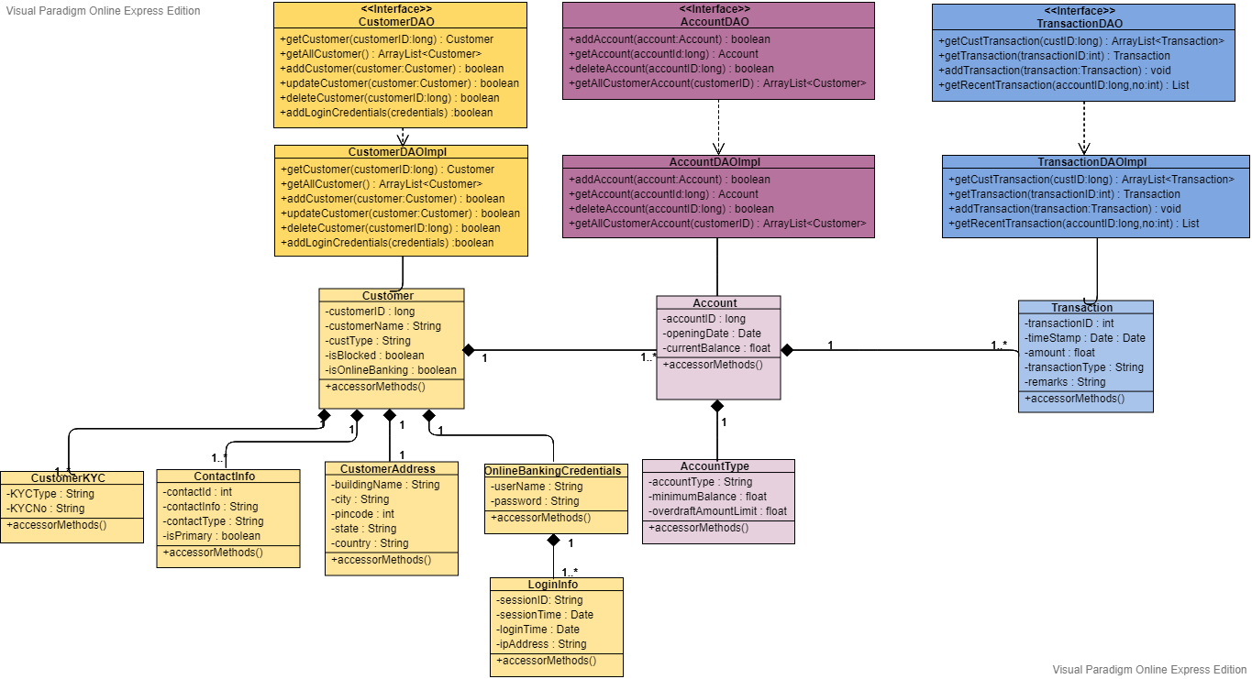
Class Diagram
(DAO
Layer)

Slide 8
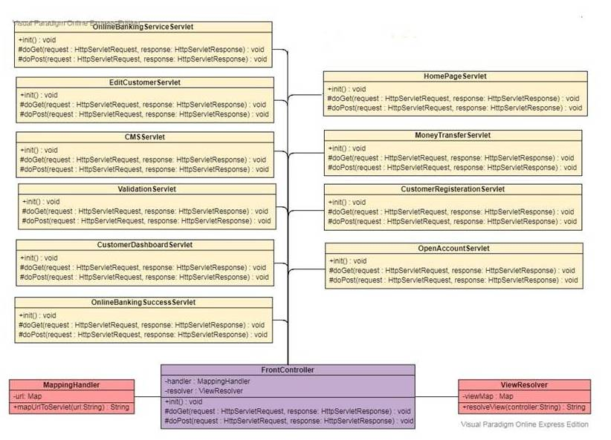
Class Diagram
(Controller Layer)

Slide 9
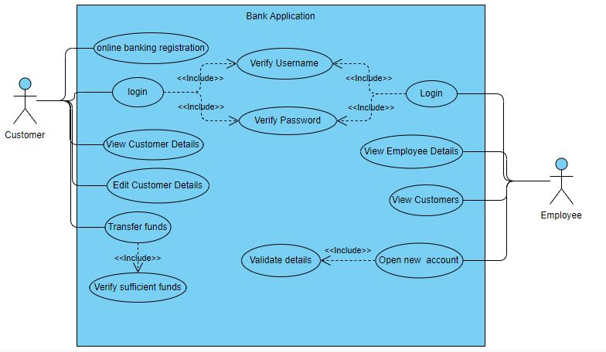
Use Case Diagram

